Slide 1
ПРЕЗЕНТАЦИЯ
К УРОКУ ПО ТЕМЕ
«Все работы хороши…»
5 класс

Slide 2



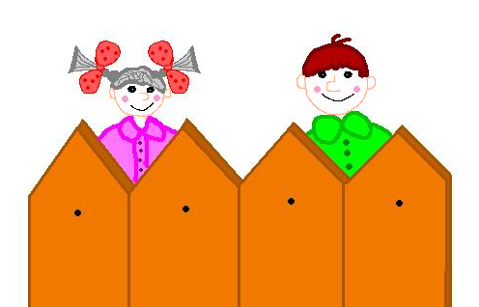

W H I C H J O B
  IS THE BEST?

Slide 3


SECRET WISHES
People sometimes say to me:
“Tell me, what do you want to be?”
I usually answer, “I don’t know”,
But it isn’t really so:
I want to win an Olympic race,
I want to see the Earth from space,
I want to travel to Timbuktu,
I want to be rich and famous too.
I want to star on Hollywood’s screen,
I want to invent a new machine,
I want to be very clever and wise,
I want to win the Nobel prize,
But most of all I want to be …

Slide 4
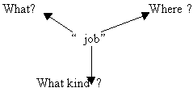


Slide 5
professions

Slide 6
What is a person?
Where does he work?
A person works on a farm | He is a farmer
A person works in a hospital. A person flies a plane. | Accountant, banker. Doctor
A person works at a factory. A person makes films | Pilot Teacher
A person works at a house A person works at a bank. | Mechanic Film maker
A person works at an agency. A person works at a shop or a supermarket. A person works at school. A person works at a workshop. | Worker, engineer Salesperson Secretary Housewife

Slide 7
HAVE TO
(HAS TO)
A TEACHER HAS TO WORK AT SCHOOL AND TEACH CHILDREN.
A PAINTER
AN ENGINEER
A LAWYER
A DOCTOR
A MODEL
A HOUSEWIFE

Slide 8

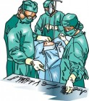

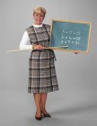




Slide 9

A TEACHER

Slide 10

A PAINTER

Slide 11

A PLUMBER

Slide 12
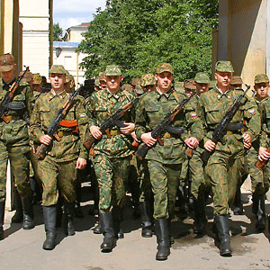
MILITARY MEN

Slide 13


Slide 14
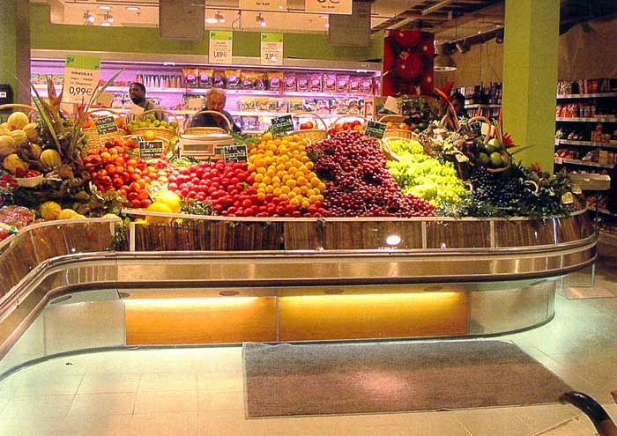
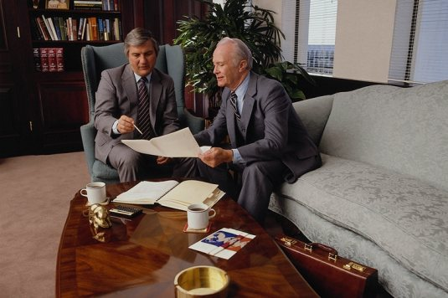
A SALESPERSON
BUSINESSMEN

Slide 15
AN ENGINEER
A BUSINESSWOMAN

Slide 16
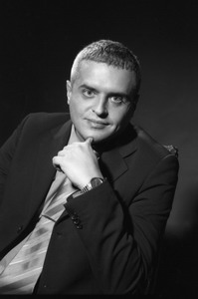

A LAWYER

Slide 17

A LIBRARIAN

Slide 18
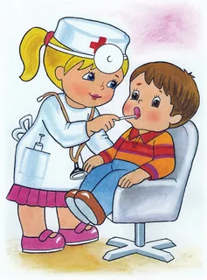
A DOCTOR

Slide 19

THE LESSON IS OVER

