Slide 1
Мы хорошо провели время в Лондоне.
Урок – путешествие
5 класс

Slide 2
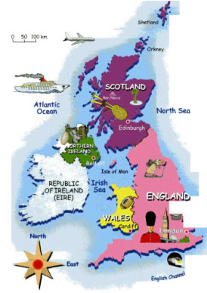
The United Kingdom of Great Britain and Northern Ireland (the UK)
This wonderful country has many different names: Great Britain, The UK or just Britain. But it has the official name. Could you name it?

Slide 3
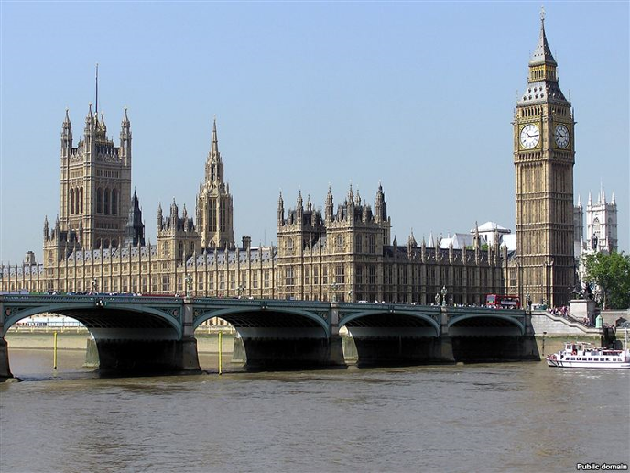
What is the capital of the UK?

Slide 4
The capital of Great Britain is London

Slide 5
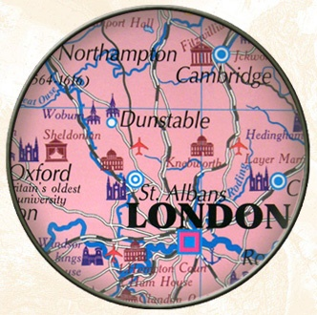
What do you imagine when you think of London?

Slide 6
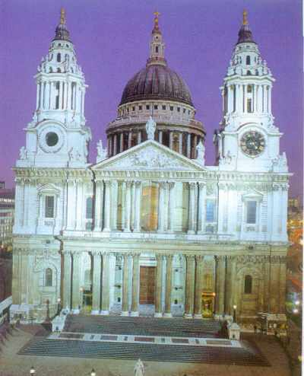
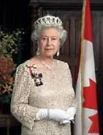
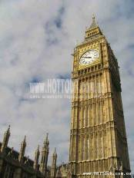
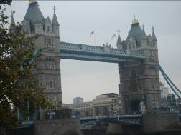
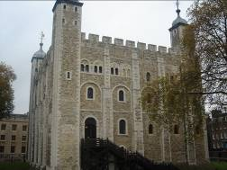
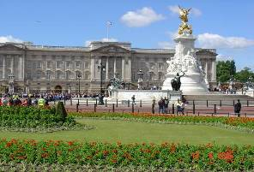
LONDON

Slide 7
Would you like to go to London?
The Queen
St. Paul’s Cathedral
The Tower of London
Buckingham Palace
Tower Bridge
Big Ben

Slide 8
I would like to go to London ...
to visit ......
to see .......
to practice English

Slide 9
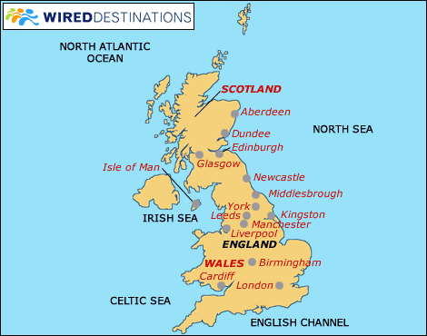

Slide 10
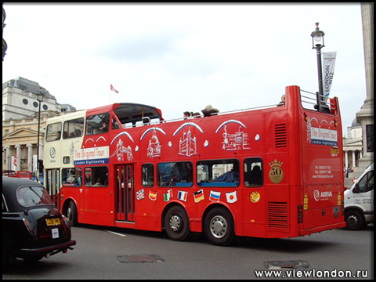

Slide 11
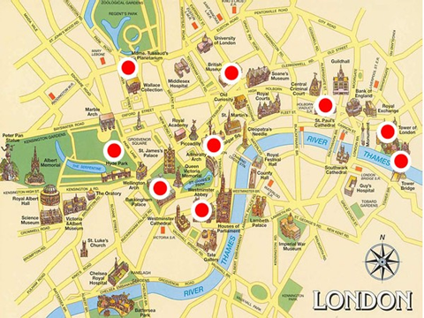

Slide 12
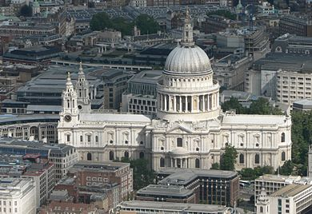
The St.Paul’s Cathedral
The St. Paul's Cathedral, the greatest of English churches. It was built in the 17th century by Sir Christopher Wren.

Slide 13
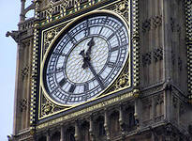
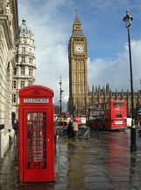
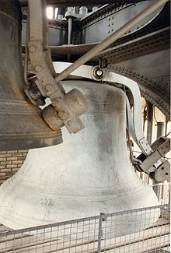
Big Ben
Big Ben is the nickname for the great bell of the clock at the north end of the Palace of Westminster in London, And often extended to refer to the clock and the clock tower.

Slide 14
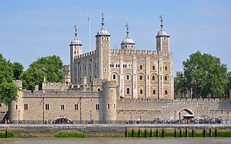
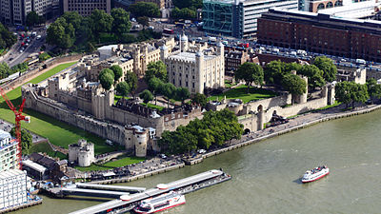
The Tower of London
The Tower of London was founded by Julius Caesar and in 1066 rebuilt by William the Conqueror. It was used as a fortress, a royal palace, and a prison. Now it is a museum.

Slide 15
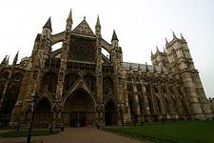
Westminster Abbey.
Westminster is the governmental part of London.
Nearly all English kings and queens have been crowned in Westminster Abbey. Many outstanding statesmen, scientists, writers, poets, and painters are buried here: Newton, Darwin, Chaucer, Dickens, Tennyson, Kipling.

Slide 16
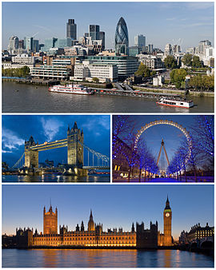
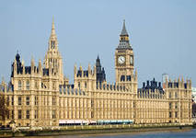
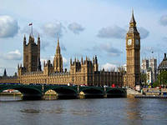
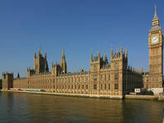
The Houses of Parliament, the seat of the British Parliament.

Slide 17
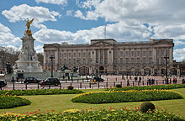
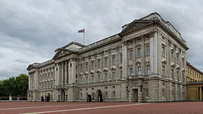
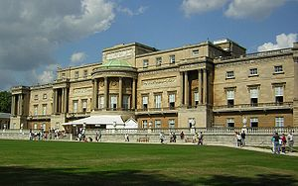
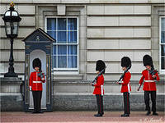
Buckingham Palace is the official residence of the Queen.

Slide 18
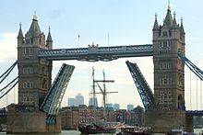
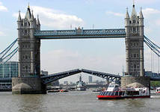
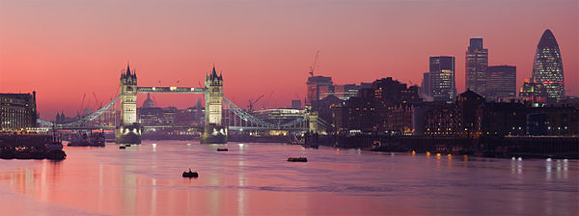
Tower Bridge
(built 1886–1894) is a combined bascule and suspension bridge in London which crosses the River Thames. It is close to the Tower of London, from which it takes its name, and has become an iconic symbol of London.

Slide 19
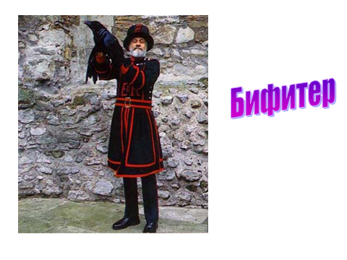

Slide 20
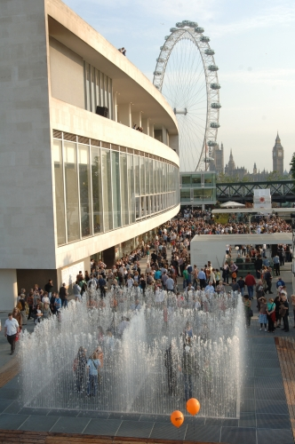
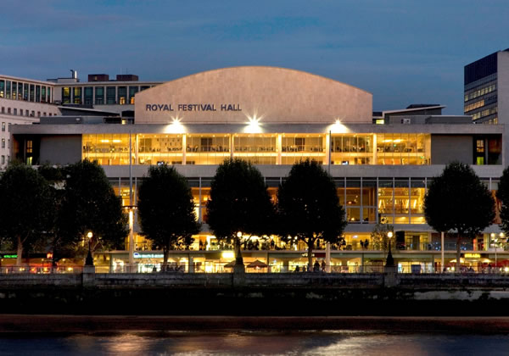
The Royal Festival Hall
The Royal Festival Hall is a 2,500-seat concert, dance and talks venue within Southbank Centre in London. It is situated on the South Bank of the River Thames, not far from Hungerford Bridge.

Slide 21
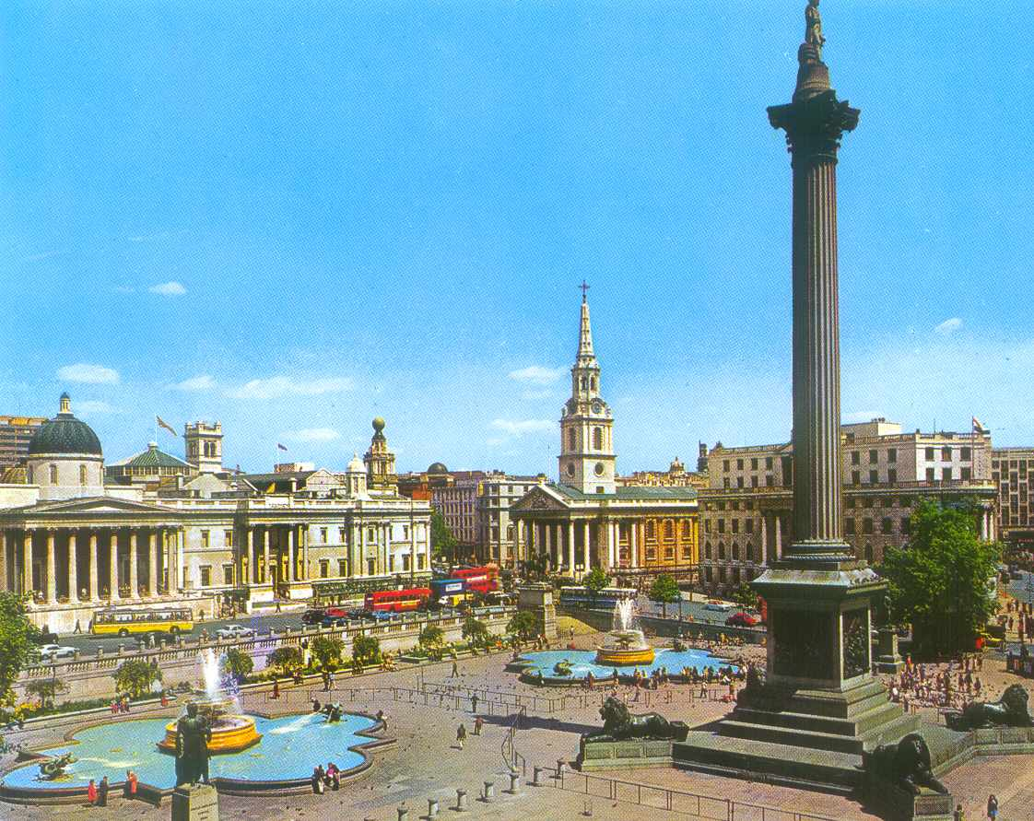
Trafalgar Square
This is one of the nerve-centres of London. It was named Trafalgar Square to commemorate the historical naval victory won on the 21st of October 1805 by the British fleet under the command of Horatio Nelson over the combined French-Spanish fleet commanded by Villeneuve.

Slide 22
Hyde Park
London is full of wonderful parks and Hyde Park is one of them. Situated in the center of London it’s considered to be a royal park. Hyde Park covers over 1, 4 square kilometers or 350 acres.

Slide 23
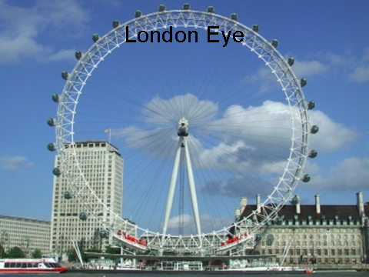

Slide 24
Repeat all together
Tower Bridge
The Tower of London
St. Paul’s Cathedral
Buckingham Palace
Trafalgar Square
Big Ben
Hyde Park
London Eye

Slide 25
Choose the right answer.
1. Buckingham Palace is the place for
a) the Queen b) the Parliament c) the businessmen
2. The Tower of London is
a) the museum b) the art gallery c) the street
3. Tower Bridge is across
a) the Rain b) the Mississippi c) the Thames
4. Big Ben is
a) the house b) the river c) the clock
5. St. Paul’s Cathedral is
a) the park b) the church c) the palace

Slide 26
What places would you like to visit?.
the Queen
Buckingham Palace
I would like to visit Big Ben
I’d like to see Tower Bridge
I want to go to London Eye
the Tower of London
St. Paul’s Cathedral

Slide 27
Match the phrases and complete the sentences.
Big Ben |  | a historic building | tourists
Buckingham Palace |  | the capital | the river Thames
London | is | famous for | its clock
Tower Bridge |  | a popular places for | of England
Trafalgar Square |  | across
The Tower
Hyde Park

Slide 28
v2

Slide 29
Использованные материалы
http://www.fcior.edu.ru
http://www.tourism-london.ru
http://www.lovelylanguage.ru
http://londonandall.com
http://pedsovet.ru
http://nsportal.ru

